Slide 1

NAMMAJAL UNITING FOR WATER WELLNESS
GUIDE
Dr. JAYAPRIYA J
TEAM MEMBERS – 4 MDS B
AKSHARA K (2348406)
ASHWINI S R (2348413)
ELIZABETH MARIYA JOSE(2348421)
M POOJA (2348435)
NAYAN HRIDYA PRAKASH (2348440)

Slide 2
AGENDA
INTRODUCTION
PROBLEM STATEMENT
OBJECTIVE
BENEFICIARIES
DATASET PREVIEW
SYSTEM ARCHITECTURE
METHODOLOGY
WEB DEVELOPMENT
DATA SCIENCE CONCEPTS USED
FUTURE ENHANCEMENT
REFERENCES

Slide 3

INTRODUCTION
NammaJal is a web app designed to address water pollution and scarcity in Bangalore using data science.
It aims to raise awareness and provide actionable insights to improve water quality and ensure sustainability.

Slide 4

PROBLEM STATEMENT
Bangalore faces severe water pollution and scarcity.
Major sources include industrial effluents, domestic sewage, and agricultural runoff.
Urgent actions are needed to restore water quality and sustainability.

Slide 5
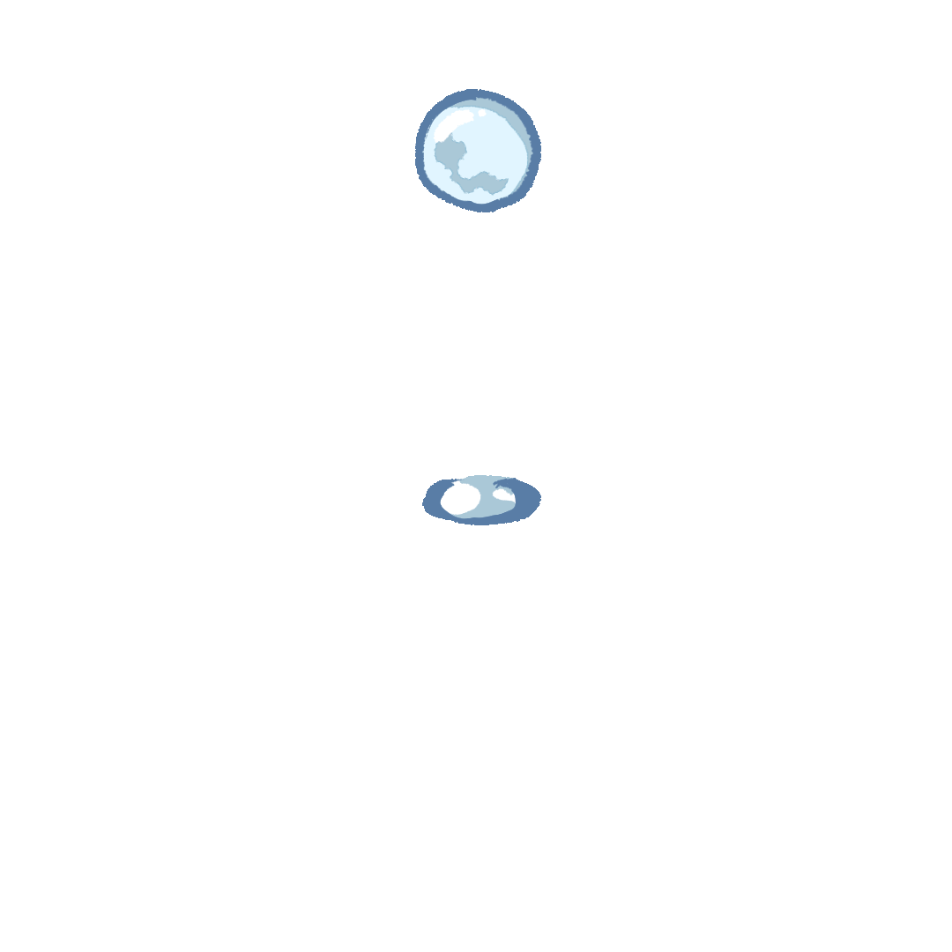
OBJECTIVE
Mitigate water pollution and scarcity in Bangalore.
Medium of Communication to restore water quality in lakes and ponds.
Awareness to improve public health and reduce waterborne diseases.

Slide 6

BENEFICIARIES
Citizens: Access to real-time water quality data and alerts.
NGOs: Enhanced collaboration and resource sharing.

Slide 7
DATASET PREVIEW
Water Quality Data: Measurements from lakes(pH, turbidity, contaminants, etc.) to assess pollution levels.
User Data: Profiles, feedback, and suggestions for NGO collaboration.
External Data Sources: Government and third-party data for accurate predictions and real-time updates.

Slide 8
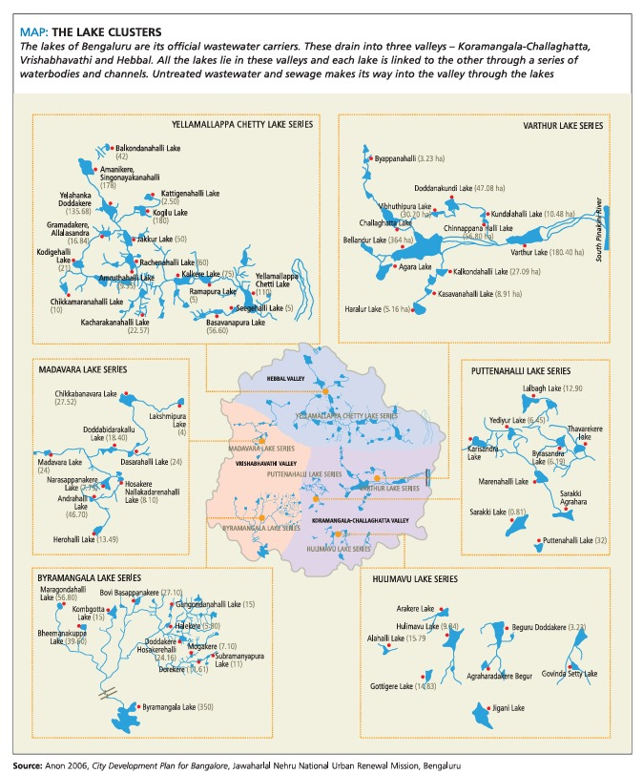

Slide 9
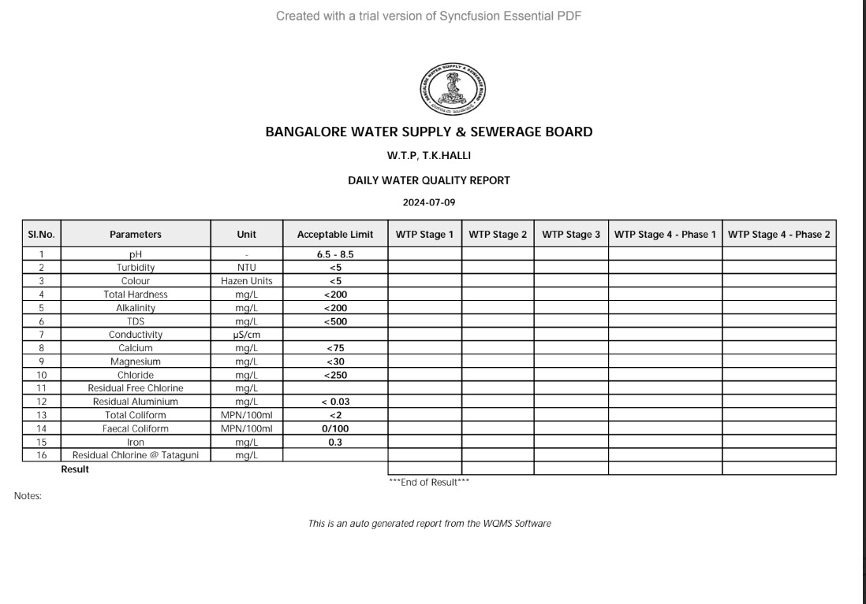

Slide 10
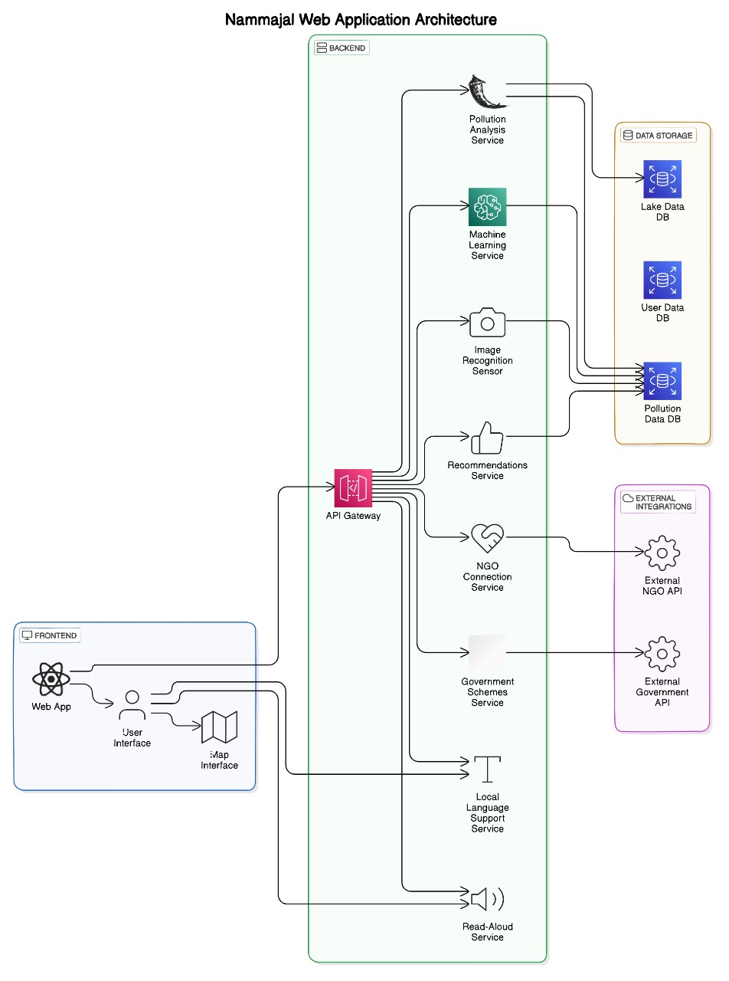
SYSTEM ARCHITECTURE
Data Processing: Cleaning, validating, and analyzing collected data.
NGO Interface: Interactive Dashboards, Reports of Insights, Recommendations.
User Interface: Interactive maps, and reports.

Slide 11

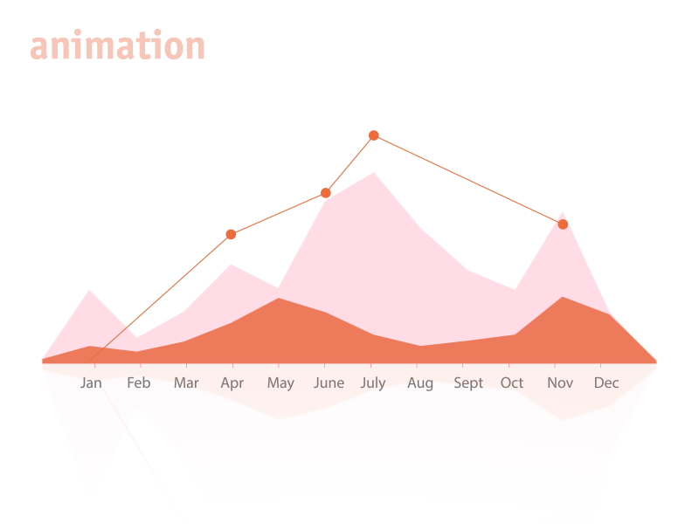

METHODOLOGY
Machine Learning: Prediction Models[Analysing Level, Cause, Effect of pollution](Random Forest), Classification Models[Polluted or not](Decision Tree).
User Engagement: Reports and educational content, Chatbot with Read Aloud option.

Slide 12
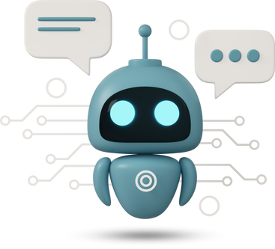

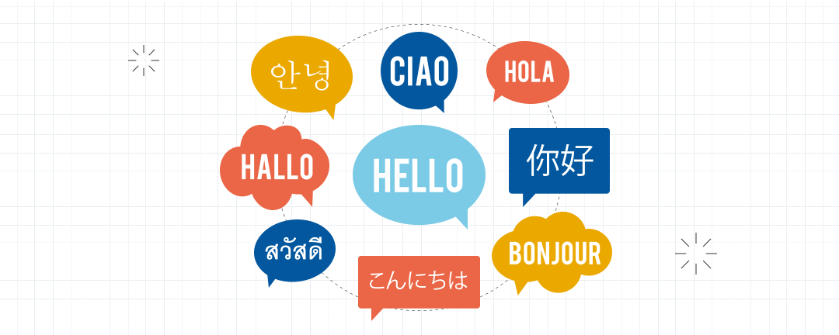

CHATBOT SUPPORT AND READ-ALOUD OPTIONS FOR EASIER ACCESSIBILITY

Slide 13



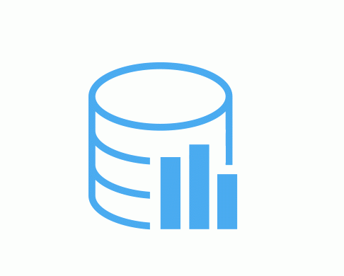
WEB DEVELOPMENT
Frontend: HTML, CSS, JS
Backend: Django for server-side operations
Database: MySQL for scalable data storage and management

Slide 14
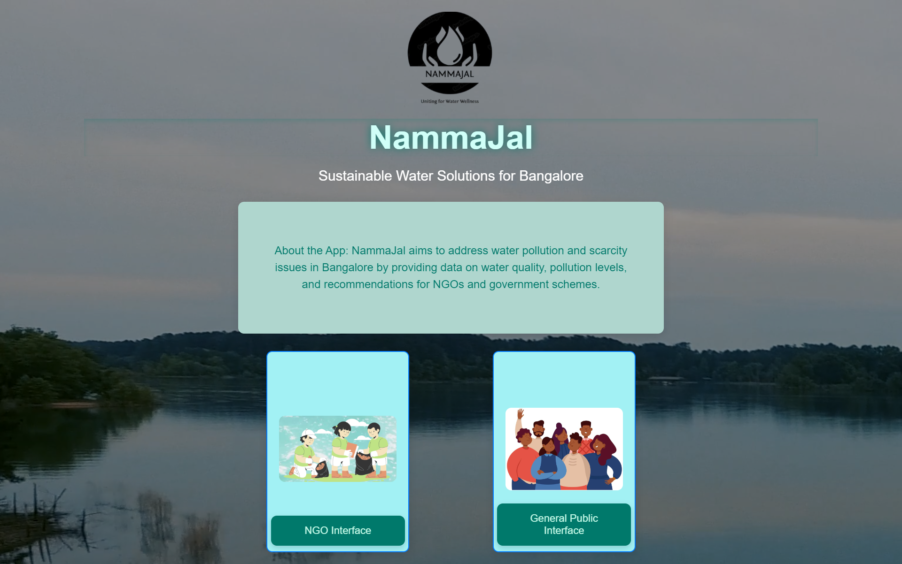
HOME PAGE

Slide 15
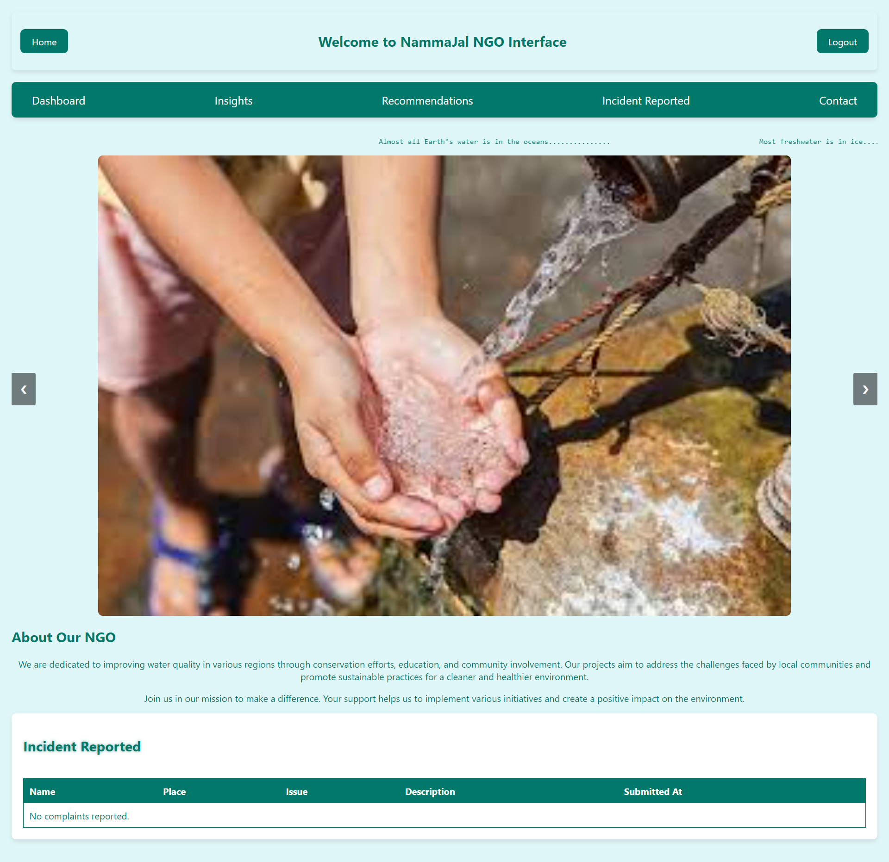
NGO_INTERFACE

Slide 16
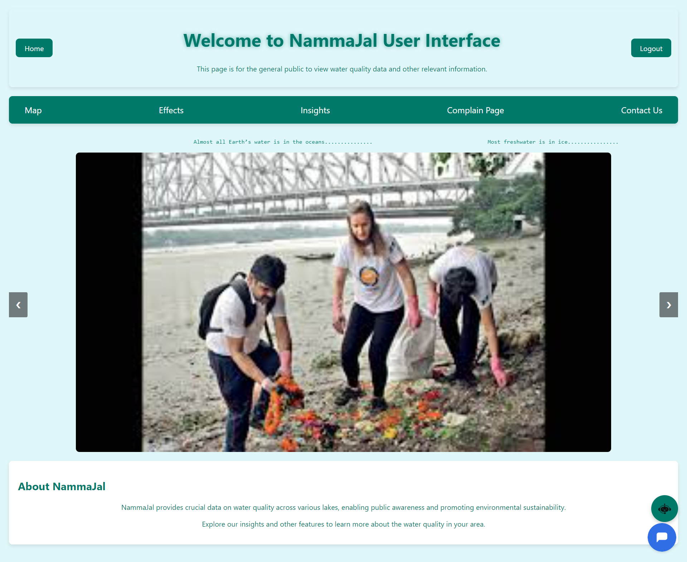
GENERAL PUBLIC INTERFACE

Slide 17
DATA SCIENCE CONCEPTS USED
Data Preprocessing and Feature Engineering: Cleaning and transforming lake pollution data, while creating relevant features for better model performance.
Supervised Learning and Model Evaluation: Using labeled data to train machine learning models for pollution classification and level prediction, evaluated through metrics like accuracy and precision.
Classification and Regression: Implementing classification algorithms to predict if a lake is polluted, and regression techniques to estimate pollution levels based on water quality data.
Pickle Serialization and API Integration: Saving trained models using pickle and integrating them with the app's frontend for real-time pollution predictions.
Data Visualization: Presenting insights on pollution levels, causes, and effects through interactive dashboards and tables.

Slide 18
FUTURE ENHANCEMENT
Model Evaluation with Real-Time Data: Assess and compare different models to determine the one with the best accuracy for optimal performance in the application.
Collaboration with NGO: Partnering with NGOs to provide real-time insights on lake pollution, enabling data-driven actions for environmental conservation.

Slide 19
REFERENCES
Problem Identification Source:
www.drishtiias.com/daily-updates/daily-news-editorials/bengaluru-s-water-crisis-a-wake-up-call-for-india
www.indiatoday.in/diu/story/bengaluru-water-crisis-karnataka-government-water-scarcity-rapid-urbanisation-climate-change
Data Collection Source:
data.opencity.in/dataset/bengaluru-lake-monthly-water-quality-reports
bwssb.Karnataka.gov.in
Literature Review:
www.sciencedirect.com/science/article/pii/S2772985022000163?via%3Dihub
www.sciencedirect.com/science/article/pii/S0144860923000602
www.researchgate.net/publication/344167317_Internet_of_Things_IoT_Based_Water_Quality_Monitoring_System

Slide 20

AKSHARA K (2348406)
ASHWINI S R (2348413)
ELIZABETH MARIYA JOSE(2348421)
M POOJA (2348435)
NAYAN HRIDYA PRAKASH (2348440)

